Slide 1

Graven Hill Residents’ Association
Annual General Meeting
Monday 22nd August 2022

Slide 2
Agenda
Welcomes/Apologies / Reminder of meeting etiquette
Agree minutes from last AGM
Chair Annual Report
Treasurer Annual Report
Events Group Annual Report
Graven Hill School – governors (Annabel Kay – Warriner Multi Academy Trust)
Appointment of new committee
AOB

Slide 3
Welcomes/Apologies (KMS/CC)
Meeting Etiquette (KMS)
Reminder re meeting etiquette - to be respectful of each other, that the Residents have a variety of views that should be heard/considered and that personal remarks about Residents, families or stakeholders are not appropriate.
Minutes – last AGM (CC)

Slide 4














Chair Annual Report August 2022
Infrastructure and Sub-Groups
Direct Engagement
Enhanced Comms

Slide 5
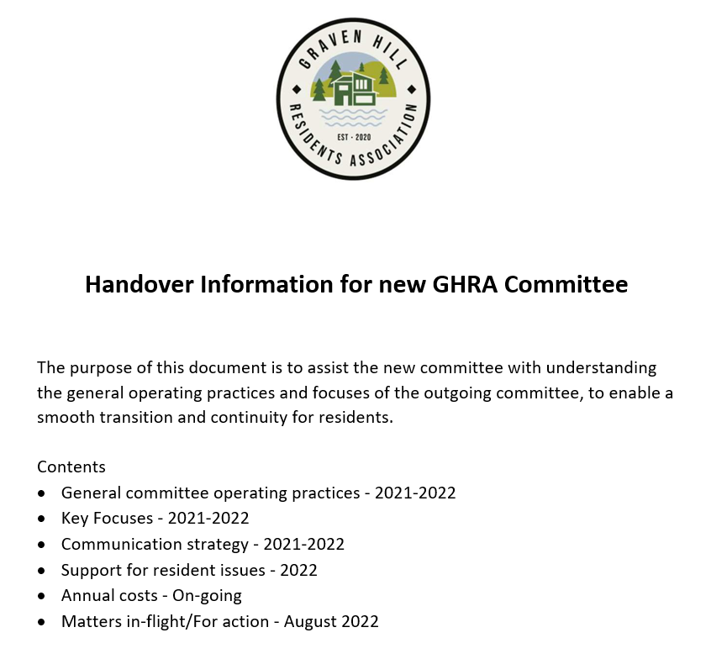
Chair Annual Report August 2022
Handover Information from
Chair for all of the committee
outgoing Secretary for the new Secretary
includes details of activities “mid-flight/requiring further action” from the new committee

Slide 6

Chair Annual Report August 2022

Slide 7
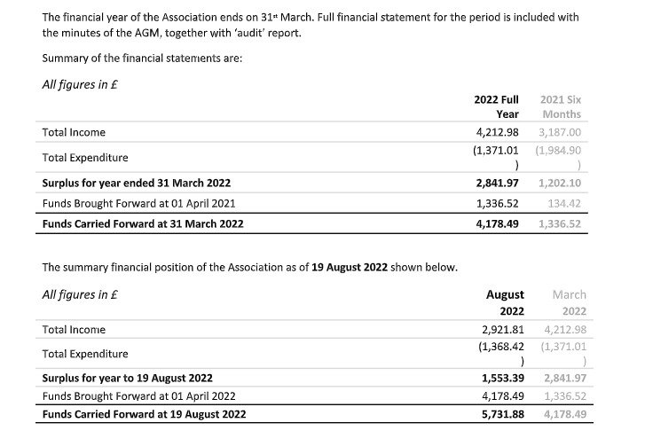
Treasurer Annual Report August 2022

Slide 8
Graven Hill Events Group 2022
We are a voluntary group
Any resident can join
Support the community
Raise funds for the community
Meet every few months – do not need to commit

Slide 9



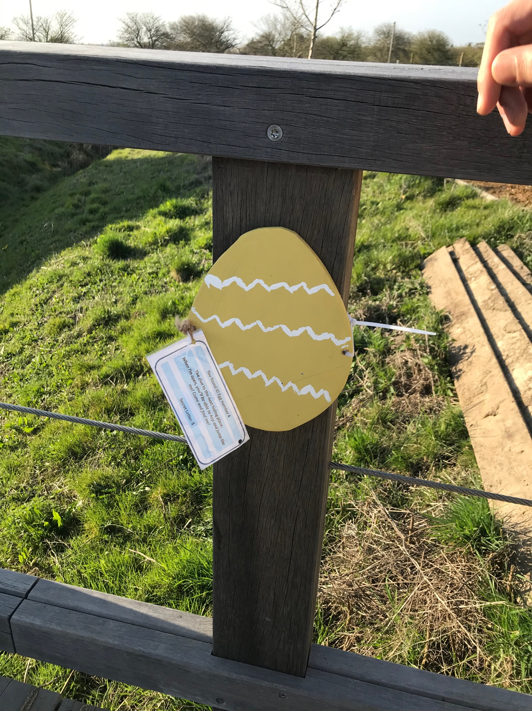
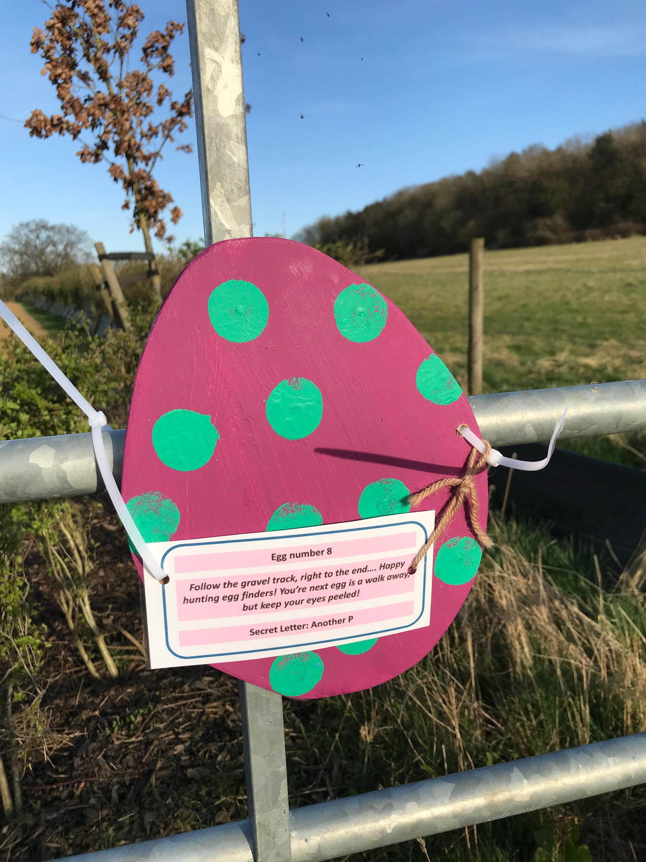

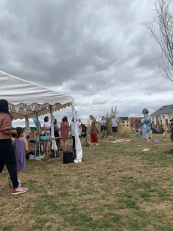

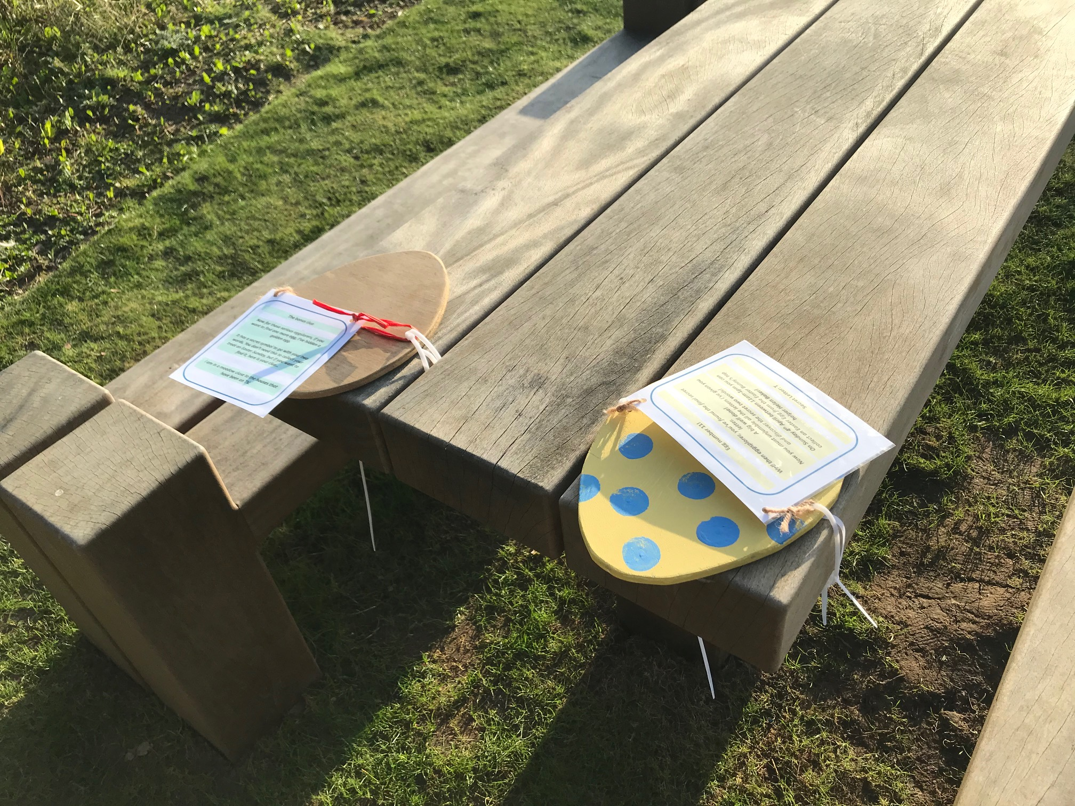

A quick look back at 2022
Easter Trail
Summer BBQ / Party
Jubilee Event

Slide 10
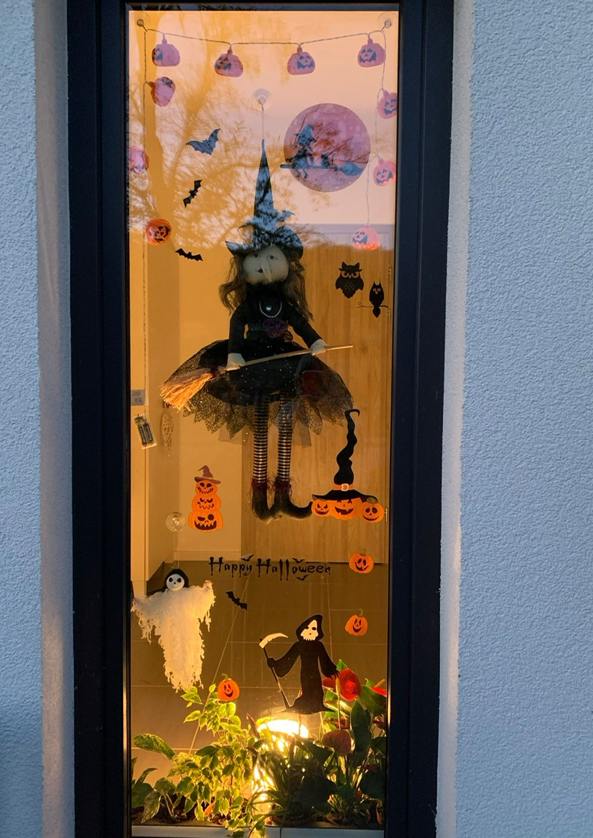

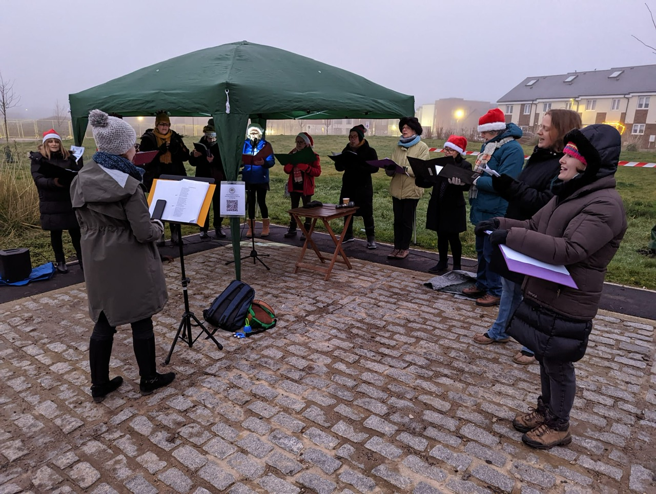





Still to come for 2022
Halloween
Remembrance Service
Advent Calendar Windows
Christmas
Event

Slide 11







How can I get involved?
Look out for our meeting dates on Facebook and the GHRA website
Have you got an idea for an event?
Would you like to help at one event but not all events?
Any suggestions are welcome
Do you like baking cakes?
Contact us:-
gravenhillevents@gmail.com

Slide 12

Graven Hill School - Governors

Slide 13
Appointment of committee
Claire El Mouden Secretary | Clare Lowe General committee | Craig Lewis General committee | Damien Maguire General committee
James Adeyemi General committee | Jo Withers General committee | Sam Omoteyo Treasurer | Stephen Aggett Chair

Slide 14
AOB

Slide 15
Graven Hill Residents Association AGM 22nd August 2022
Thank you for attending!

